Slide 1
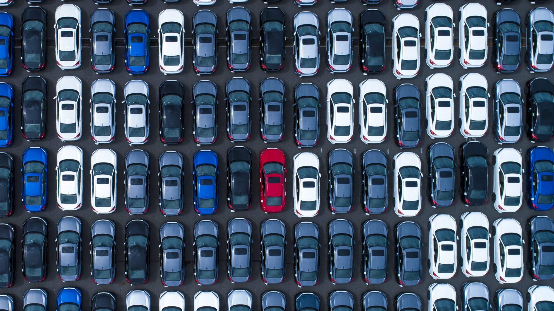
NYC UBER TRIPS Overview Including Weather and Holiday Impacts
By: Rania Al-Samarai,
Oanh Nguyen,
Axel Keller,
Anna Whitaker
C H A T G P T
Notes:
Anna

Slide 2
AGENDA
Overview of the Data Sets
Question 1 – How did the number of Uber Drivers and associated trips evolve over the course of this data set?
Question 2 – What impact does weather have on Uber trip volumes, if any?
Question 3 – Is there a difference in Uber ride volumes between weekdays vs weekends? Does higher precipition impact that?
Question 4 – Did the holidays in this data set have a positive or negative impact on uber trip volumes compared to non holiday days?
Conclusion
Notes:
Anna

Slide 3
Overview of Data Sets
Data sets:
Uber Data – https://www.kaggle.com/datasets/fivethirtyeight/uber-pickups-in-new-york-city
Weather Data - https://www.visualcrossing.com/
Data clean:
Merged the two data sets.
Confirmed no missing data in the merged data frame.
Potential data set shortfalls
Uber data is a small sample size.
Notes:
Anna:
Data sample size could cause issues with drawing broad conclusions around uber trip volumes + weather.

Slide 4
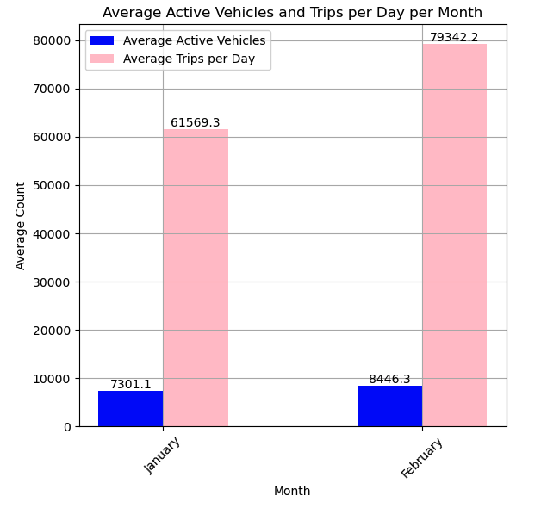
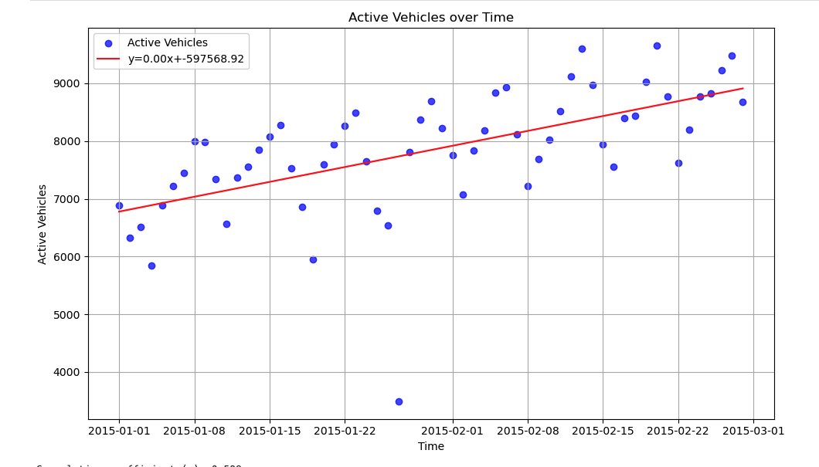
Question 1:
How did the number of Uber Drivers and associated trips evolve over the course of this data set?
Active vehicles grew significantly between the two months.
Trips per day grew quicker than active vehicles.
Notes:
Anna:

Slide 5
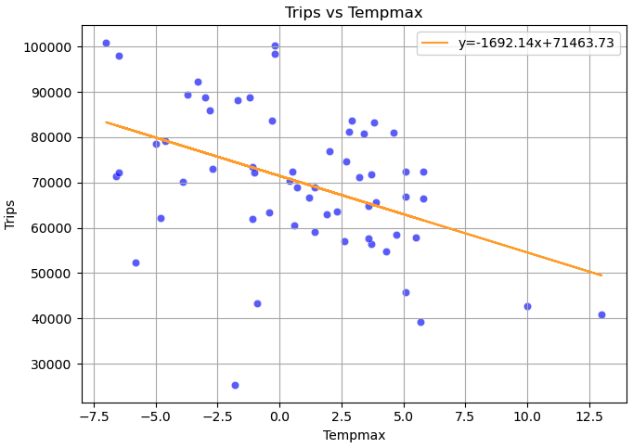
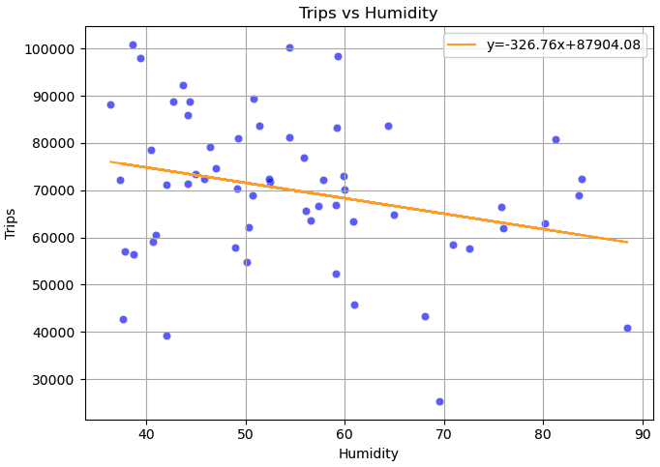
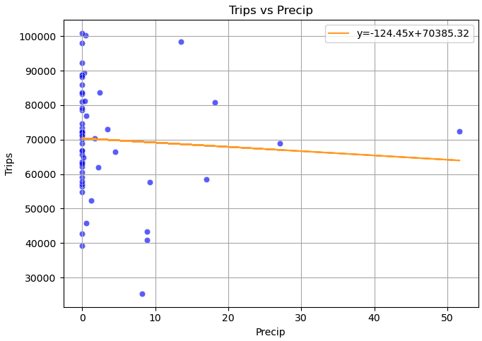
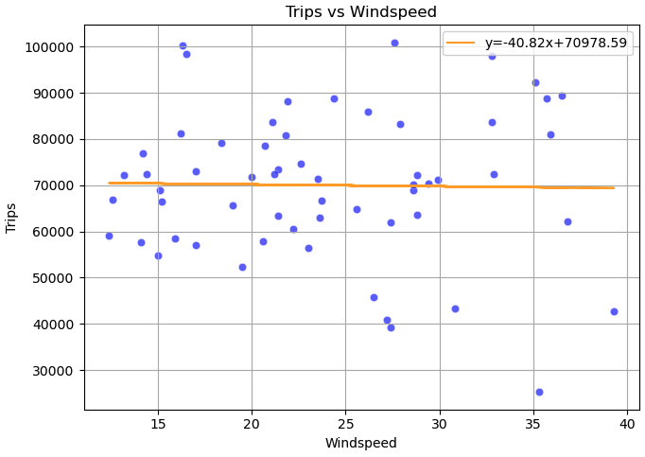
Question 2: What impact does weather have on Uber trip volumes, if any?
Assumption: Precipitation vs trip volume would be highest correlation.
Highest weather correlation with trip volume was the max temperature, second highest was the humidity, and precipitation and windspeed had insignificant correlation.
Notes:
Axel:
Our team assumed that precipitation would have the highest impact on trip volume as no one wants to walk around in the rain. But this isn’t what the data showed us.
As precipitation rose, there was little to no correlation with uber trip volumes. Potentially, the data set didn’t have enough days to accurately represent high precipitation days.
As temperature rose to a comfortable level, uber trip volume decreased.
As humidity rose, uber trip volume decreased.
As windspeed rose, there was little to no correlation with uber trip volumes.

Slide 6
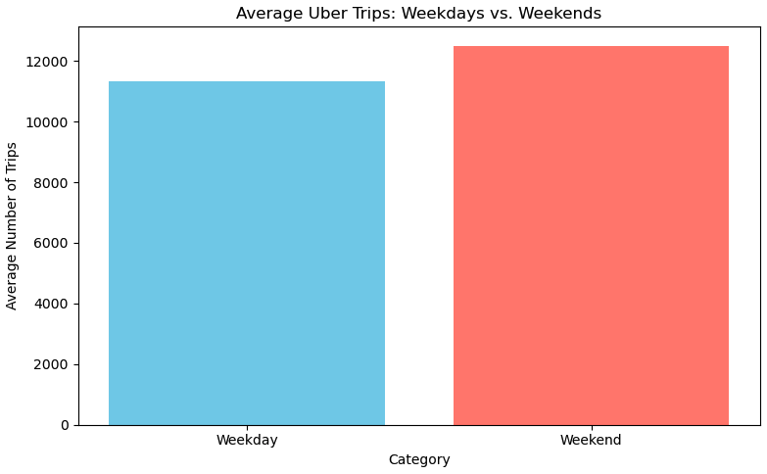
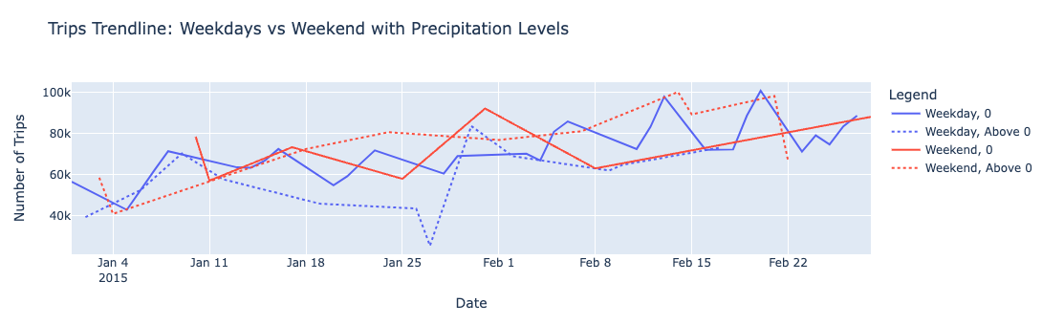
Question 3:
Is there a difference in Uber ride volumes between weekdays vs weekends? Does higher precipitation impact that?
Weekend trip volume > Weekday trip volume
With the addition of precipitation variable, weekday trip volume is consistent, but weekend trip volume when precipitation is above 0 has the highest volume days.
Notes:
Rania:
Our team assumed that weekend trips would be higher than weekends, which the data set supported.
Another assumption was that weekday and weekend trips with higher precipitation days would have higher trip volumes than the days with 0 precipitation.
You can see that the graph shows the weekend days with precipitation >0 have the highest volume days. But, there isn’t a concise comparison of weekdays with precipitation.
Due to the small data set, high precipitation days weren’t accurately represented as Axel showed previously.

Slide 7
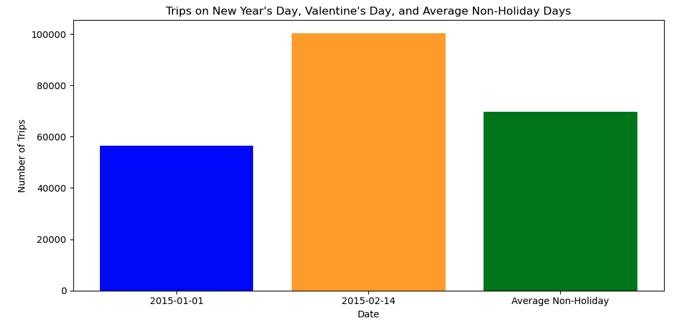
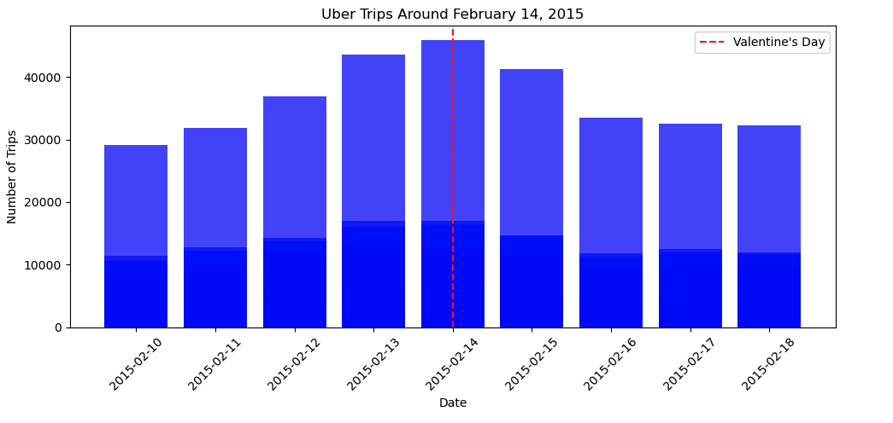
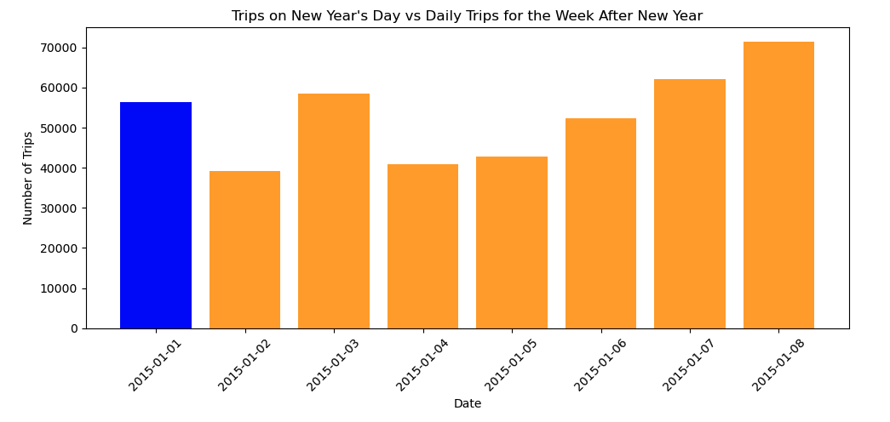
Question 4: Did the holidays in this data set have a positive or negative impact on uber trip volumes compared to non-holiday days?
Assumption: Uber trip volumes on the holidays would be higher than non holiday days.
When comparing to Non-Holiday days, Valentine’s day trips were higher, but New Year’s Day trips were lower.
Notes:
Oanh:
Our team assumed the Uber trip volumes on the holidays would be higher than non holiday days.
You can see that Valentines day followed that assumption, but new years day did not. There are multiple potential reasonings that this could be the case, maybe people in NYC are more likely to go out on Valentine’s Day and New Year’s Eve, rather than New Year’s day.
Due to the small sample size of our data set, we cannot make broad assumptions regarding holiday’s impact on uber trip volumes, but it was interesting to see the impacts for 2015.

Slide 8
CONCLUSION
Uber drivers and uber trip volumes increased over the two-month span of this data set.
Highest weather correlation with trip volumes was max temperature.
Weekend uber trip volumes are higher than weekday uber trip volumes, on average.
Valentine’s day trip volumes were significantly higher than the average of non-Holiday trip volumes.
Small sample size of data set impact's ability to make broad assumptions.
Notes:
Oanh

Slide 9
THANK YOU!
C H A T G P T
Notes:
Oanh

